Slide 1
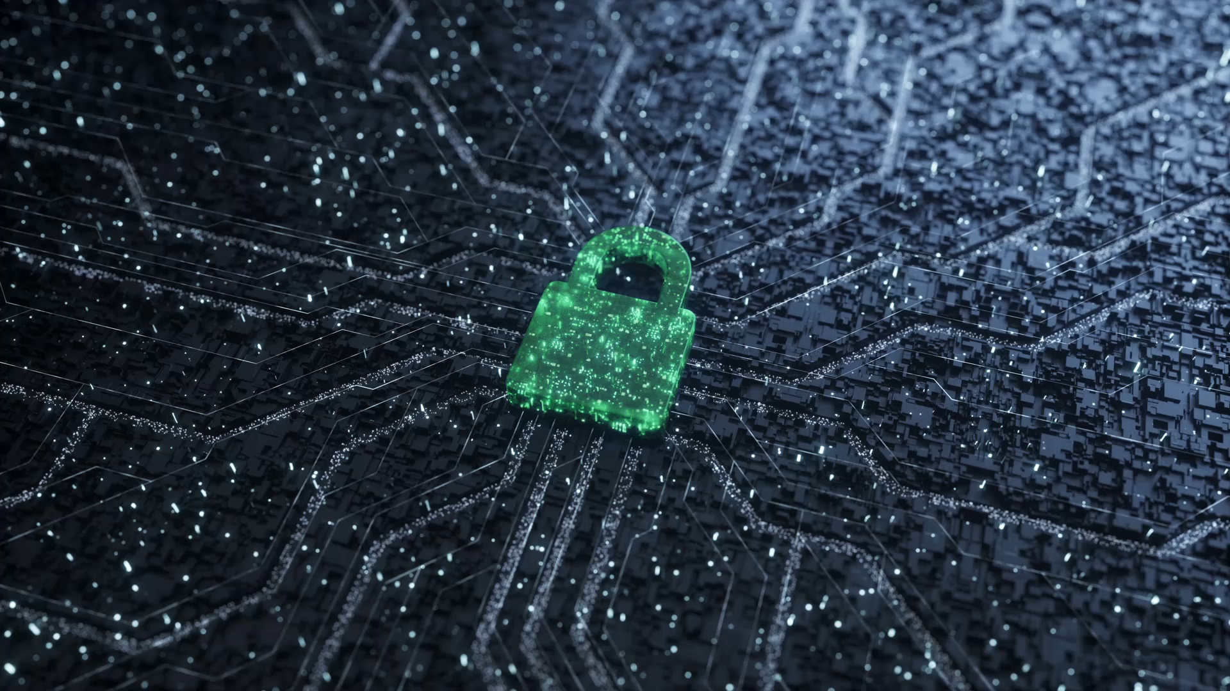
BLOCKCHAIN
Presented by :
Walid AHMED MESSAOUD
Soraya RAIAH

Slide 2

Summary
What is a blockchain ?
History of blockchain
How it works ?
Technology used in Block Chain
The potential of blockchain
Domain of application
Misuse and concern of Blockchain

Slide 3
What is Blockchain ?
Blockchain is a technology for storing and transmitting information, transparent, secure, and operating without a central control body.
By extension, a blockchain constitutes a database that contains the history of all the exchanges made between its users since its creation. This database is secure and distributed .It is shared by its different users, without intermediaries, which allows everyone to check the validity of the chain.

Slide 4
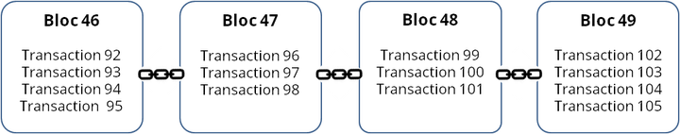
What is Blockchain ?
There are public blockchains, open to everyone, and private blockchains, the access and use of which is limited to a certain number of actors.

Slide 5
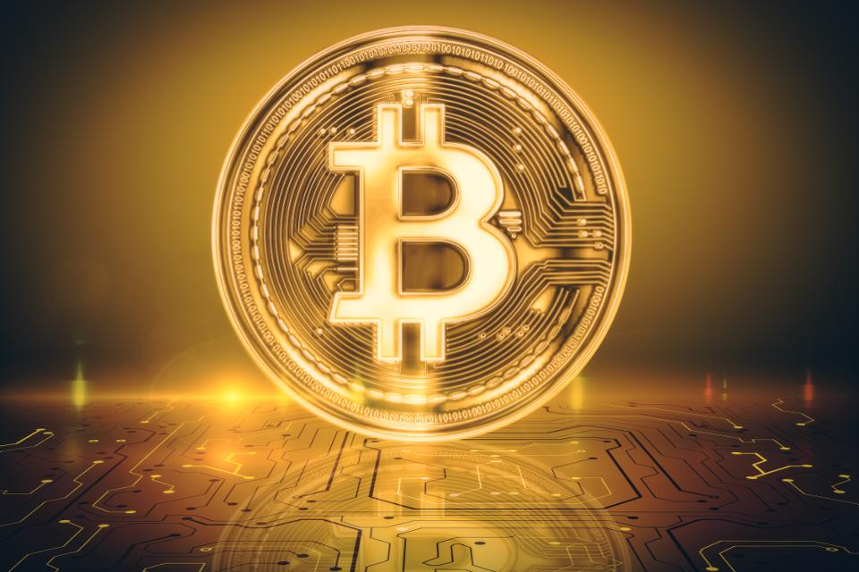
History of Blockchain
The first blockchain appeared in 2008 with the bitcoin digital currency, developed by an unknown person appearing under the pseudonym Satoshi Nakamoto.

Slide 6
How it works ?
Any public blockchain necessarily works with a programmable currency or token. Bitcoin is an example of a programmable currency.
Transactions between network users are grouped in blocks. Each block is validated by the nodes of the network called “miners”, according to techniques which depend on the type of blockchain. In the bitcoin blockchain this technique is called “Proof-of-Work”, and consists in solving algorithmic problems.
Once the block is validated, it is time stamped and added to the block chain. The transaction is then visible to the receiver and the entire network.

Slide 7
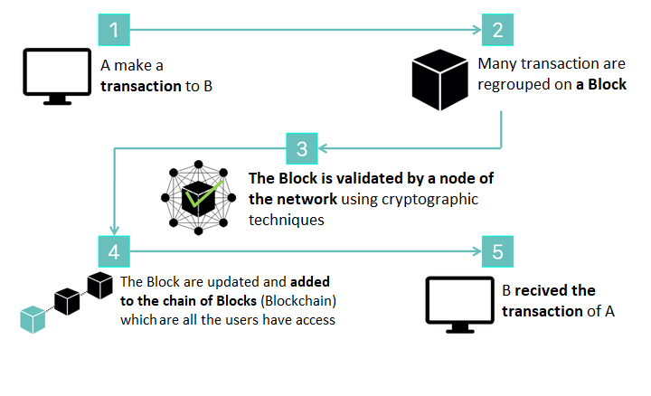
How it works ?

Slide 8
How it works ?
This process takes a certain time depending on the blockchain we are talking about (about ten minutes for bitcoin, 15 seconds for Ethereum).
For example, a "node“ have a transaction file on a computer ("registry"). Two public accountants ("miners") have the same register on their respective computers. When transaction is completed , the computer sends an email to each accountant to let them know. And each accountant rushes to be the first to verify this transaction (and earn their salary in "Bitcoins"). The first to perform the verification and validation presses "RESPOND TO ALL“. And attaches its transaction verification technique (the "proof-of-work"). If the other accountant agrees, everyone updates their file ...
This operation is made possible by “blockchain” technology.

Slide 9
Technology used in Blockchain
Cross-Chain bridges
Decentrelized Finance(DeFi)
Vechain
Hash-Rate
Smart contract
Distrebuted Ledger Technology (DLT)

Slide 10

The potential of Blockchain
Blockchain can be applied as a registry to ensure better traceability of products and assets.
It provides high-end data and transaction security and is more reliable compared to the other means of data storage.
The technology is cost effective as it cuts down the cost of maintenance and middlemen vastly.
Transactions are traceable and highly transparent on blockchain

Slide 11
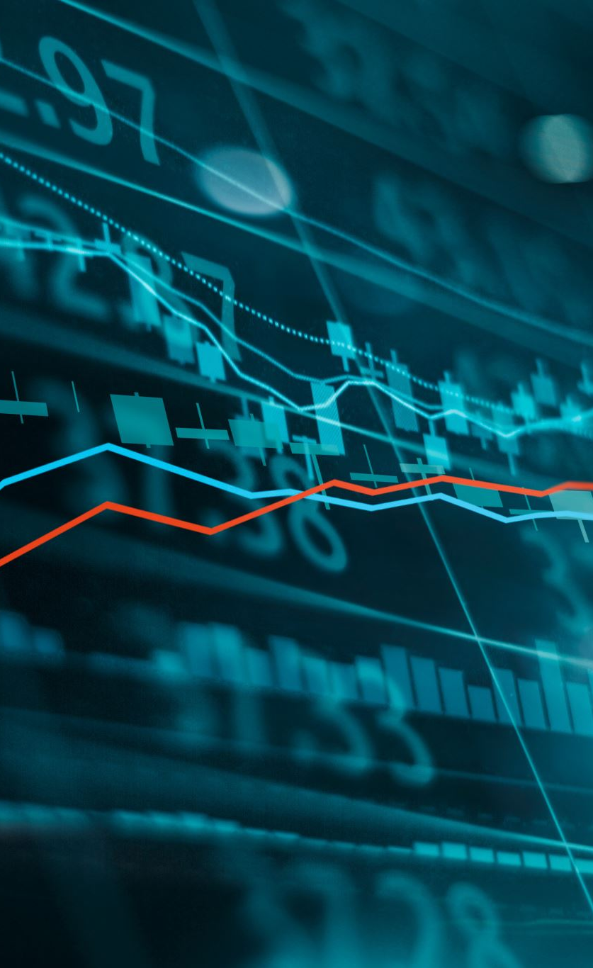
Potential applications
Financial services: Streamlining payments, automating transactions, and improving record-keeping.
Supply chain management: Tracking goods and materials from origin to destination, enhancing transparency and efficiency and optimize logistics.
Voting systems: Enabling secure and verifiable elections.
Healthcare: Managing medical records and facilitating secure data sharing
Current state: Blockchain technology is still evolving, with ongoing research and development to address scalability and security challenges. Its real-world applications are growing, but widespread adoption is yet to be achieved.
Internet of Things (IoT): Blockchain can secure data communication between devices, while big data can analyze sensor data to improve performance and efficiency.

Slide 12
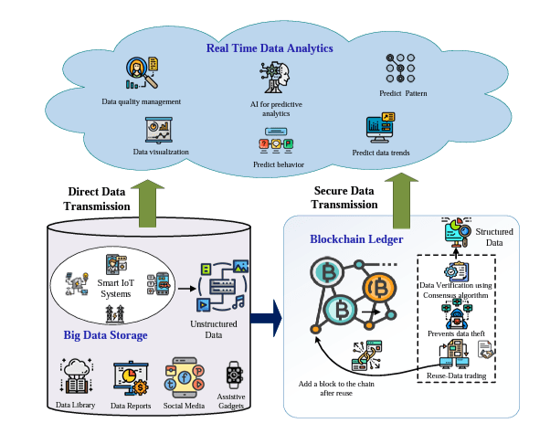
Blockchain and Big data
Blockchain's tamper-proof, decentralized nature helps secure data storage and transactions, reducing privacy concerns and with Big data analytics can glean valuable insights from this data for trend analysis, fraud detection, and network optimization.

Slide 13
Misusing of Blockchain
Financial Crime:
Investigate how cryptocurrencies and blockchain are used for money laundering, illegal transactions, and funding illicit activities. Analyze different techniques and tools employed by criminals.
Technical Vulnerabilities
Deep dive into specific vulnerabilities like 51% attacks, phishing scams, and smart contract bugs. Explain how they can be exploited and potential mitigation strategies.
Data Privacy Concerns:
Discuss the implications of storing personal data on a public ledger, including risks of identity theft, data manipulation, and lack of control. Analyze potential solutions for privacy-preserving blockchain applications.
Environmental Impact:
Analyze the energy consumption of proof-of-work blockchains and potential solutions for more sustainable implementations. Explore alternative consensus mechanisms like proof-of-stake

Slide 14

Conclusion and Opinion
Blockchain has evolved from a revolutionary concept to a maturing technology with immense potential. Challenges like scalability and privacy persist, but ongoing research and development offer promising solutions. The future of blockchain lies in its integration into real-world applications and its potential to drive positive societal change. The regulatory landscape surrounding blockchain is still evolving, requiring clear guidelines and frameworks to foster innovation while mitigating risks.

Slide 15
Thank you for your attention.

